Slide 1
VSLAM Co-operating UAVs
Thesis Members: Cornejo, Juan Raphael M.
Mapili, Lorenzo Mari A.
Pesit, Rigel
Young, Emmett
Thesis Adviser: Engr. Elmer R. Magsino

Slide 2
Presentation Overview:
Introduction
Statement of the Problem
Scope and Delimitations
Hardware Interfaces for UAVs
Minor Developments
Major Developments
Data and Results
Concluding Remarks

Slide 3
Introduction

Slide 4
Introduction
There have been several researches that further advances the autonomous capabilities of mobile robots.
SLAM gives the robots the ability to perceive the world and where they are in the world.
The PARADOX: a robot cannot localize without having a map and it cannot create a map without knowing its location.
In this study, co-operating autonomous exploration of robots is concerned.
Notes:
There have been several researches that further advances the autonomous capabilities of mobile robots. Among the prevailing topics is the SLAM which gives the robots the ability to perceive the world and where they are in the world. It answers the paradox of a robot cannot localize without having a map and it cannot create a map without knowing its location. In this study, however, co-operating autonomous exploration between robots is concerned.

Slide 5
Introduction
We present a modified open-source RGB-D SLAM that aims to address the problem of multi-robot SLAM.
The modified RGB-D SLAM system was tested with quadrotors which are equipped with RGB-D cameras as the only sensor for solving the SLAM problem.
Two quadrotors are tasked to autonomously explore an unknown indoor environment using a 2D navigation stack while still producing a 3D map using RGB-D SLAM.
We would also describe the implementation of a control interface where the RPYT channels of a commercially available flight controller can be controlled to achieve autonomous flight control.
Height and yaw position control were also implemented.
Notes:
With localization and mapping, autonomous operations are possible such as surveillance, coverage and exploration. The study focuses on autonomous exploration of uncharted territories. Autonomous operation module must be able to communicate properly with quadrotors. The commands received by the quadrotors must be then used for navigating the robot to its desired position and orientation. It follows that from the highest levels of abstraction such as logic and reasoning down to the low level embedded system such as fabricating boards for sensor data acquisition and controlling of actuators, as well as the programs that come with it must be clearly defined.

Slide 6
Statement of the Problem
Recent developments in autonomous mapping have major limitations that greatly decrease their productivity. Certain mapping robots have successfully and individually mapped its surrounding environment at a rather slow pace and minimal area due to the restrictions of their system, such is its battery life. One recently existing autonomous mapping system which made use of a quadrotor used a Microsoft Kinect camera and other sensors to achieve its goals. This system has successfully mapped multi-floored buildings quite effectively. However, due to the short battery life of a quadrotor (roughly 10-15 minutes), the system has a limited mapping area.
Another notable autonomous mapping system consists of multiple ground robots with cameras. This system successfully generates a 2D map after each machine is assigned an area on a master computer. Certain locations may not be reachable for the co-operating robots due to their limitations as ground vehicles.

Slide 7
Statement of the Problem
When dealing with visual simultaneous localization and mapping (VSLAM), difficulties in individual mapping would lie in pose and location estimation of each of the robots since any inaccuracy in a mapping iteration, due to limited sensor precision and noise, would magnify and carry on to the next. These difficulties, however, should be addressed by implementing a VSLAM algorithm which would then be extended to support co-operation. However a new problem arises when fusing the information from different multiple quadrotor platforms to produce one coherent map.

Slide 8
Scope and Delimitation
Only two (2) quadrotors are to be employed.
Controlled working environment (e.g. static, lighted and indoor environment)
Exploration is limited within Wi-Fi signal range and on a single floor.
Autonomous operation greatly depends on the localization.
Since the study focuses on the application use of quadrotors, the design of an original flight control system is not of concern in this study.

Slide 9
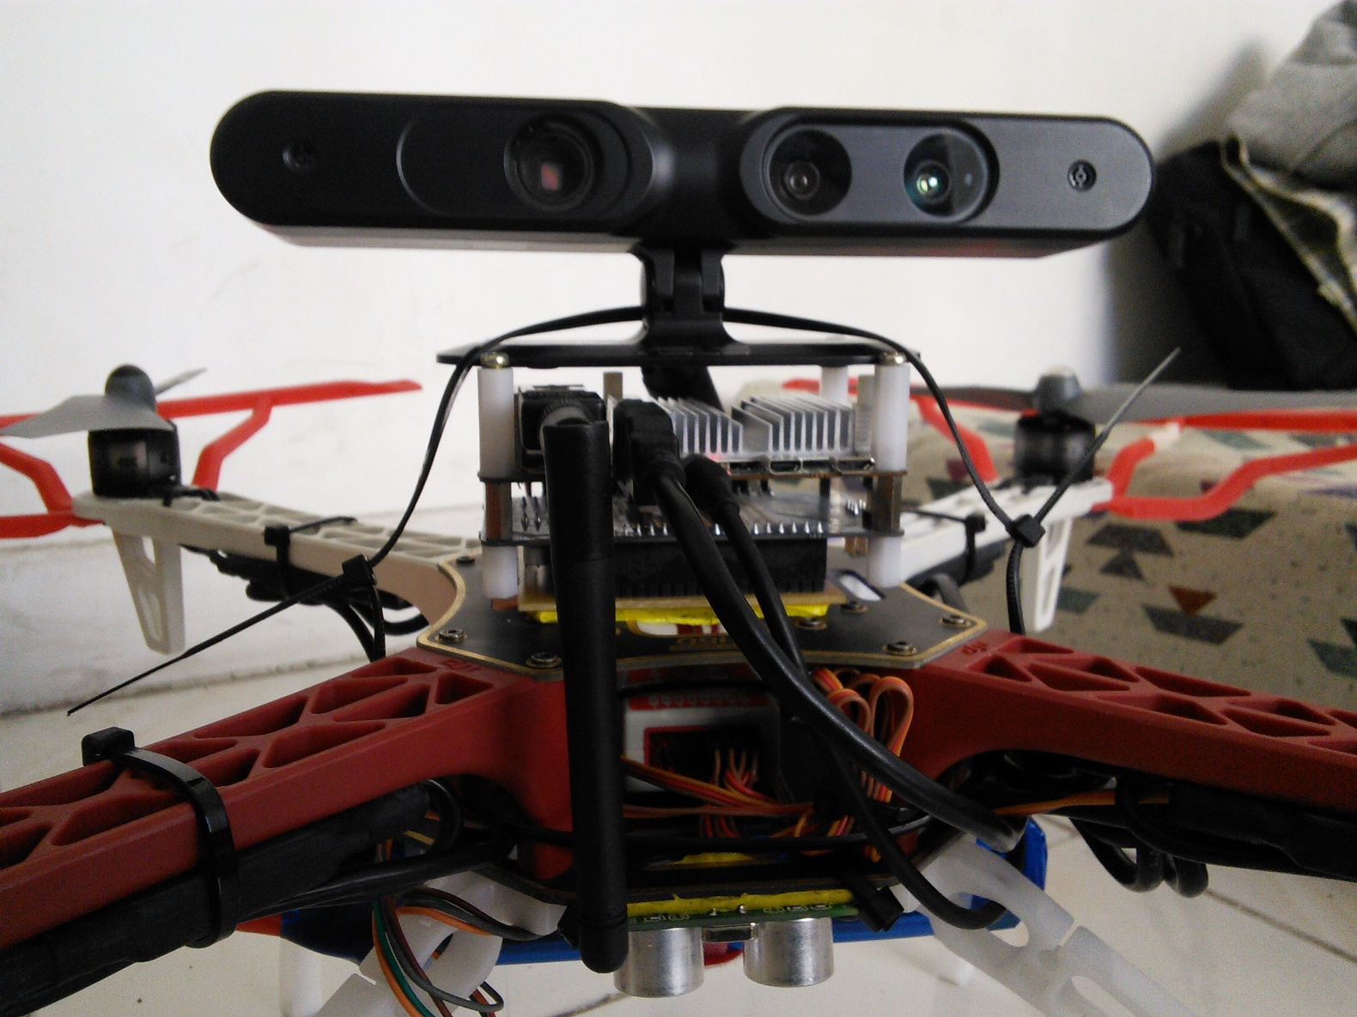
Hardware interfaces for uavs
Odroid U3
Odroid U3 I/O Shield
WiFi dongle
Xtion Pro Live
Ultrasonic Sensor
Lipo Battery

Slide 10
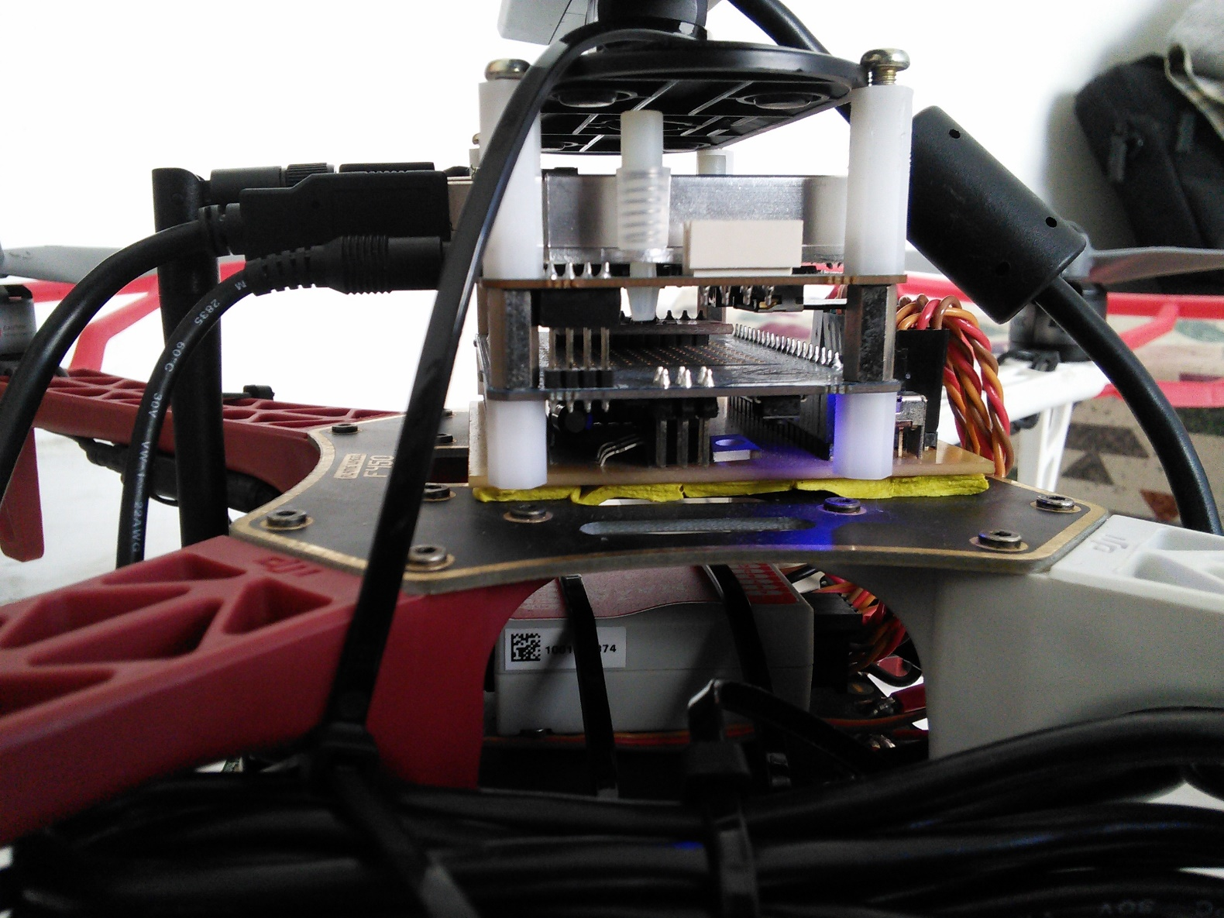
Hardware interfaces for uavs
IMU
Flight Controller

Slide 11
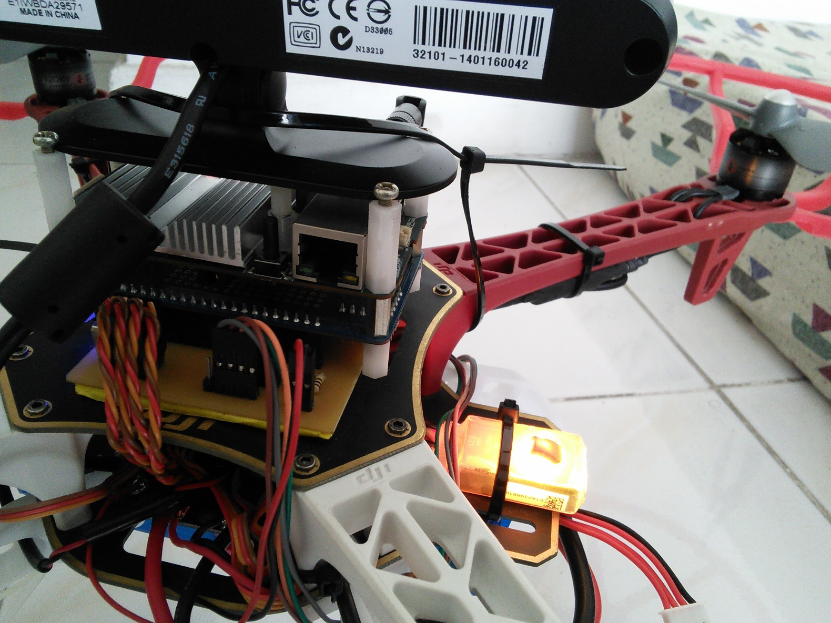
Hardware interfaces for uavs
I/O Shield Breakout board
Battery Monitoring System
Versatile Unit
ESCs
Motor

Slide 12
Minor Developments
Notes:
Minor Developments
Communication Module (odroid listener & odroid serial)
Telemetry
Control tests
Communication Module
Notes:
Communication plays a vital role in the process of the system. With the use of TCPROS (a transport layer for ROS messages and services) exchange of messages between the different components of the system is done with ease. The on-board processor of the quadrotor as discussed in the hardware interfaces is equipped with a wireless adapter which is used to establish communication with the base station computer. Through TCPROS and a WIFI connection the on-board processor can transmit and receive data to and from the base station computer. We created a communication module (odroidlistener) in the on-board processor to handle all the incoming and outgoing wireless data. Data coming from the base station computer are commands that are used to control the flight operation of the quadrotor while data coming from the on-board processor are telemetry data which are used to monitor the status of the quadrotor. The communication module passes command data to the different controller modules we have created to control the flight movements of the quadrotor. Another communication module that was created (odroidserial) is in charge of transmitting and receiving data from the arduino (IO Shield) through serial communication. Data from the sensors pass as well as data to the flight controllers pass through this module.
The Telemetry module is created in order to monitor the quadrotors' actual and goal height and yaw as well as the battery levels. Included in the telemetry module are the command controls which are used to give manual commands such as start/unstart, arm/disarm, land, and set goal height/yaw to the quadrotor's on-board processor.

Slide 13
Major Developments

Slide 14
Quadrotor control
The Conventional Way
A Flight Controller receives commands of PWM signals from the receiver.
These signals correspond to the stick positions of a radio transmitter.
The signal consists of a servo command, a 1ms to 2ms pulse in a 20ms period.
These commands are sent to four (4) channels, namely:
Aileron – controls the roll
Elevator – controls the pitch
Throttle – controls the throttle
Rudder – controls the yaw

Slide 15
Quadrotor control
Implemented quadrotor control
The Flight Controller receives commands of PWM signals from the I/O Shield.
The I/O Shield receives a value from 1000 to 2000 from the Odroid U3 which is translated to microseconds.
The signal consists of a servo command, a 1ms to 2ms pulse in a 20ms period.
These commands are sent to four (4) channels, namely:
Aileron – controls the roll
Elevator – controls the pitch
Throttle – controls the throttle
Rudder – controls the yaw

Slide 16
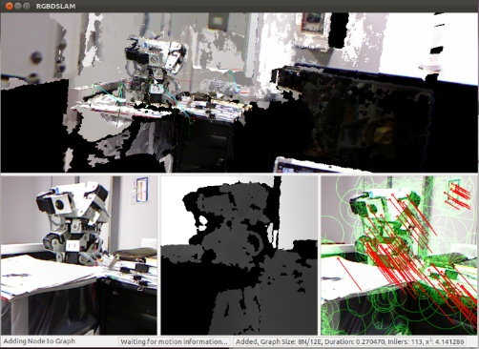
MULTI RGBDSLAM
a modified version of the RGBDSLAM, an open-source graph-based SLAM system that uses an RGB-D camera to create a colored 3D representation of the environment

Slide 17
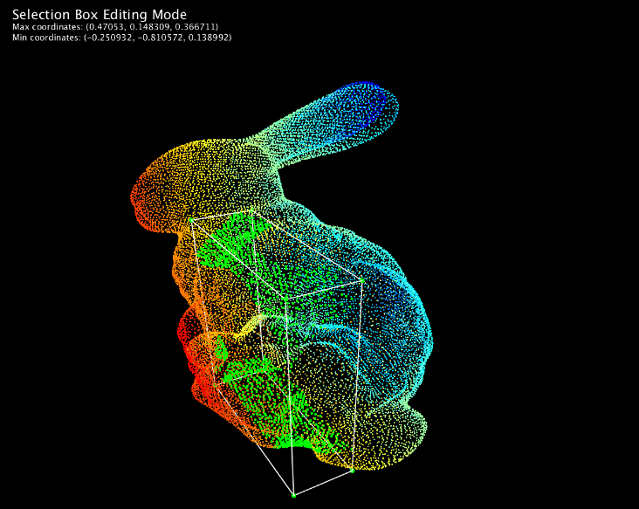
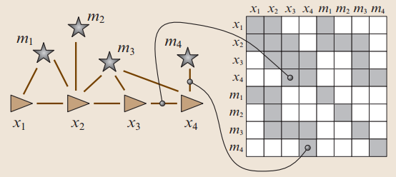
MULTI RGBDSLAM
uses the General (Hyper) Graph Optimization (g2o) library to store and optimize the graph of SLAM system
uses the Point Cloud Library (PCL) to visualize the RGB and depth images in 3D

Slide 18
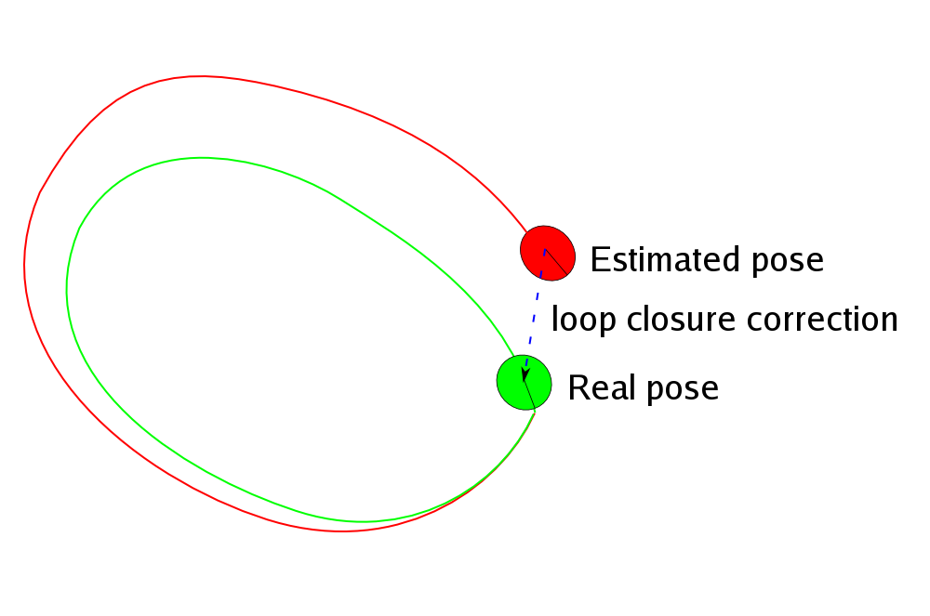
MULTI RGBDSLAM
performs loop closure, a technique performed when previous landmarks are recorded again after a period of time; the estimated trajectory from the span of time is adjusted to make the same landmark be placed on the same coordinates.

Slide 19
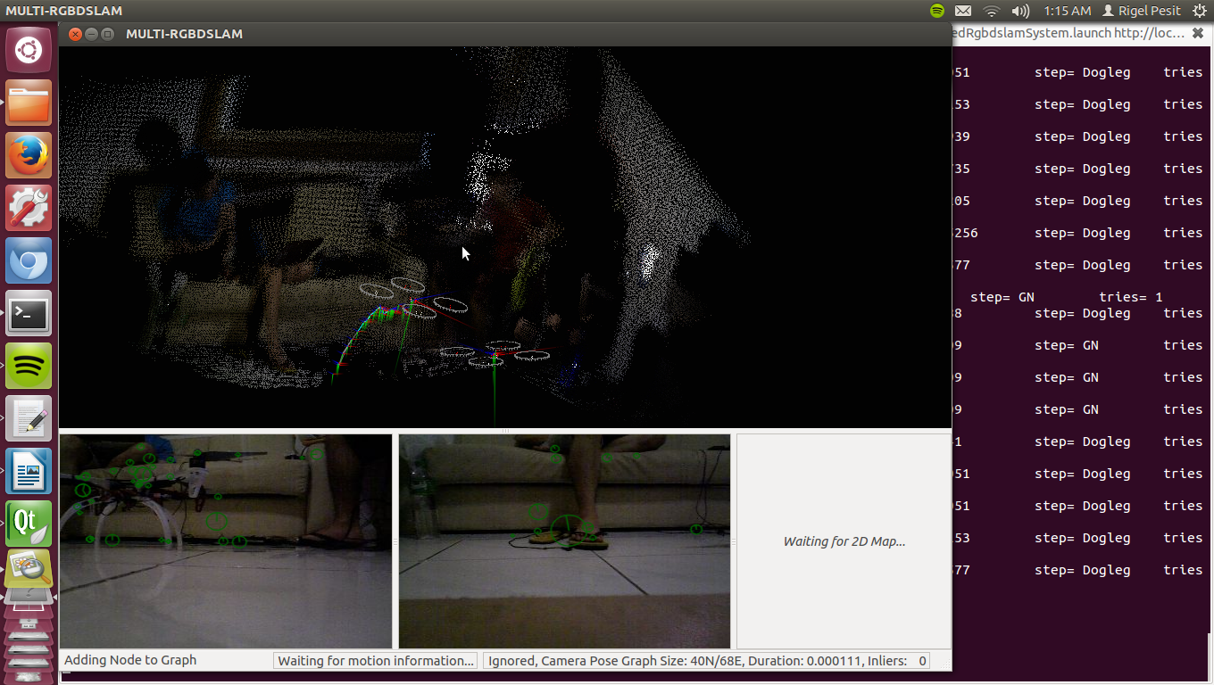
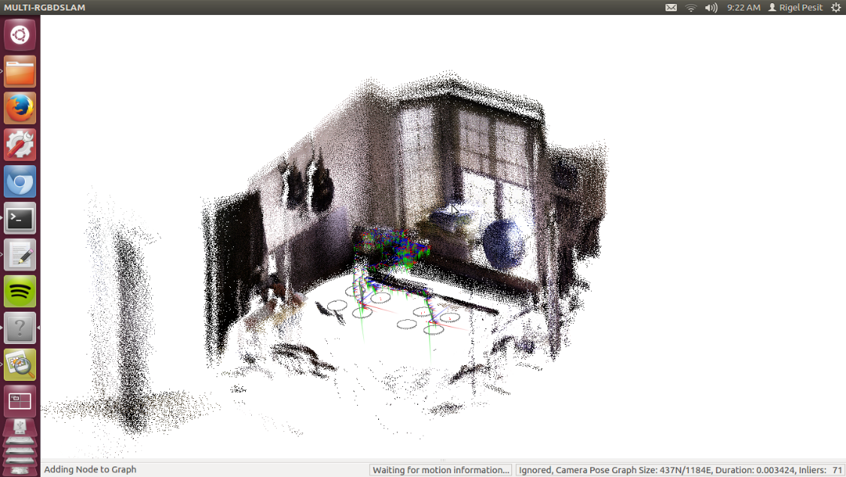
MULTI RGBDSLAM
modifications were made such that the system can make use of user adjustable number of cameras instead of just one while still being able to maintain the system’s ability to loop close.

Slide 20
Navigation Stack
Notes:
For the autonomous operation, we present here the navigation stack from one of the lectures of Dr. Sturm entitled Autonomous Navigation for Flying Robots.
It shows the hierarchy of relationships between different modules that ultimately provides autonomous operation to mobile robots once integrated. As evidently seen, autonomous operation is extremely difficult as the higher layers of operation greatly depends on its lower layers; one unstable module may cause failure to the autonomous operation. The low-level embedded systems which reads the sensor readings and controls the actuator which enables the robot to interact with the physical world can be used as the foundation of higher level robotic applications such as position control. The position control takes in its goal position and uses sensors to provide pose estimation of the robot to provide motor commands to the robot until it successful reach the goal and holds its position.
The foundation discussed above is to be utilized in the autonomous operation and the planning can be split into four parts namely, task planner, mission planner, global planner and local planner. We do not need the task planner as it again only adds another layer which serves as a friendly user interface to non-geeky people which can then be used for commercial purposes.
We only adapted the mission planner, global planner, global map generation by SLAM, local planner and localization. Since dynamic environments is not of concern in this study, the part of local planner and position control were combined and simplified.
The goal of the mission planner as defined by Dr. Sturm is to generate and execute a plan to accomplish a certain (navigation) task which varies from exploration, coverage, surveillance and tracking. For this study, the task chosen was exploration of uncharted territory. The exploration algorithm is to be implemented in the mission planner which eventually must be interfaced to the global planner. Especially as in the case of cooperation, the mission planner must take into account the current position of both robots in the map to intelligently make target assignments for each robot that seeks to minimize the overall cost and maximize the information gain as fast as possible.
The global planner is also known as the path planner. Given destination goal point from the mission planner, it takes the occupancy grid map and the current position of the robot and compute a collision-free path starting from the pose of the robot towards the goal. However, the robot is not point in size. The radius of the robot must be taken into account when constructing the path. Dr. Sturm argued that inflating the map is the solution. The inflation of the map was performed by the use of distance map and were used for both the mission and global planner.
The role of the local planner would only be just to move from point A to point B, keeping at its best to follow the path.

Slide 21


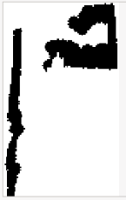

Mission planner
Notes:
The mission planner is composed of primarily two steps namely frontier detection and target assignment for each robots. Frontier detection is used for identifying unexplored areas which are characterized by the boundary between free and unknown cells. We begin by retrieving the latest ternary map and binary map. Ternary map represents the original grid map which contains three values namely free, occupied and unknown cells. To get the binary map, we filtered the ternary map such that every unknown cells become free cells. We proceed in performing canny edge detection for both ternary and binary map. Our concern here is to only get the frontier edges which can be done by just subtracting the binary edge image from ternary edge image. We dilate the frontier edge image to remove false frontier edges which are basically noises. Our goal here is to identify the coordinates of the frontiers. For this reason, the OpenCV library offers a contour detection function that takes in the frontier edge image and returns the contours as a 2D array. We computed the center of gravities of each contours to summarize the contours into one point. However, since the global planner cannot make paths through unknown and occupied cells and there is the great possibility of the center of gravities fall unto the unknown area which happens, the frontier goals must be relocated. For this operation, Dijkstra’s algorithm was used to relocate the frontier goal to the nearest free cell.
Given a set of frontier goals and the current position of the robots, hungariam algorithm was used in computing the optimal target assignments for each robots. The cost matrix was derived from Dijkstra’s algorithm which also effectively filters unreachable targets from each robots.

Slide 22


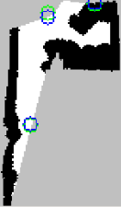
Mission planner
Notes:
The mission planner is composed of primarily two steps namely frontier detection and target assignment for each robots. Frontier detection is used for identifying unexplored areas which are characterized by the boundary between free and unknown cells. We begin by retrieving the latest ternary map and binary map. Ternary map represents the original grid map which contains three values namely free, occupied and unknown cells. To get the binary map, we filtered the ternary map such that every unknown cells become free cells. We proceed in performing canny edge detection for both ternary and binary map. Our concern here is to only get the frontier edges which can be done by just subtracting the binary edge image from ternary edge image. We dilate the frontier edge image to remove false frontier edges which are basically noises. Our goal here is to identify the coordinates of the frontiers. For this reason, the OpenCV library offers a contour detection function that takes in the frontier edge image and returns the contours as a 2D array. We computed the center of gravities of each contours to summarize the contours into one point. However, since the global planner cannot make paths through unknown and occupied cells and there is the great possibility of the center of gravities fall unto the unknown area which happens, the frontier goals must be relocated. For this operation, Dijkstra’s algorithm was used to relocate the frontier goal to the nearest free cell.
Given a set of frontier goals and the current position of the robots, hungariam algorithm was used in computing the optimal target assignments for each robots. The cost matrix was derived from Dijkstra’s algorithm which also effectively filters unreachable targets from each robots.

Slide 23
Mission planner
Given a set of candidate frontiers and two robot’s poses, Hungarian algorithm computes the optimal target assignments for each robot.
The cost matrix was derived from Dijkstra’s algorithm which effectively filters unreachable targets from each robots.

Slide 24
Navigation Stack
Notes:
For the autonomous operation, we present here the navigation stack from one of the lectures of Dr. Sturm entitled Autonomous Navigation for Flying Robots.
It shows the hierarchy of relationships between different modules that ultimately provides autonomous operation to mobile robots once integrated. As evidently seen, autonomous operation is extremely difficult as the higher layers of operation greatly depends on its lower layers; one unstable module may cause failure to the autonomous operation. The low-level embedded systems which reads the sensor readings and controls the actuator which enables the robot to interact with the physical world can be used as the foundation of higher level robotic applications such as position control. The position control takes in its goal position and uses sensors to provide pose estimation of the robot to provide motor commands to the robot until it successful reach the goal and holds its position.
The foundation discussed above is to be utilized in the autonomous operation and the planning can be split into four parts namely, task planner, mission planner, global planner and local planner. We do not need the task planner as it again only adds another layer which serves as a friendly user interface to non-geeky people which can then be used for commercial purposes.
We only adapted the mission planner, global planner, global map generation by SLAM, local planner and localization. Since dynamic environments is not of concern in this study, the part of local planner and position control were combined and simplified.
The goal of the mission planner as defined by Dr. Sturm is to generate and execute a plan to accomplish a certain (navigation) task which varies from exploration, coverage, surveillance and tracking. For this study, the task chosen was exploration of uncharted territory. The exploration algorithm is to be implemented in the mission planner which eventually must be interfaced to the global planner. Especially as in the case of cooperation, the mission planner must take into account the current position of both robots in the map to intelligently make target assignments for each robot that seeks to minimize the overall cost and maximize the information gain as fast as possible.
The global planner is also known as the path planner. Given destination goal point from the mission planner, it takes the occupancy grid map and the current position of the robot and compute a collision-free path starting from the pose of the robot towards the goal. However, the robot is not point in size. The radius of the robot must be taken into account when constructing the path. Dr. Sturm argued that inflating the map is the solution. The inflation of the map was performed by the use of distance map and were used for both the mission and global planner.
The role of the local planner would only be just to move from point A to point B, keeping at its best to follow the path.

Slide 25
Global and Local Planner
The global planner takes in the inflated map, current pose and goal in creating a collision-free path using Dijkstra’s algorithm.
The global planner only forwards valid path to the local planner.
The local planner receives an array of points that represent the path and converts them into yaw and pitch commands.

Slide 26
Data and Results

Slide 27
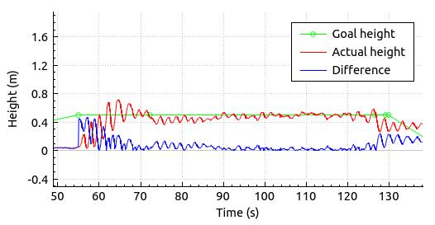
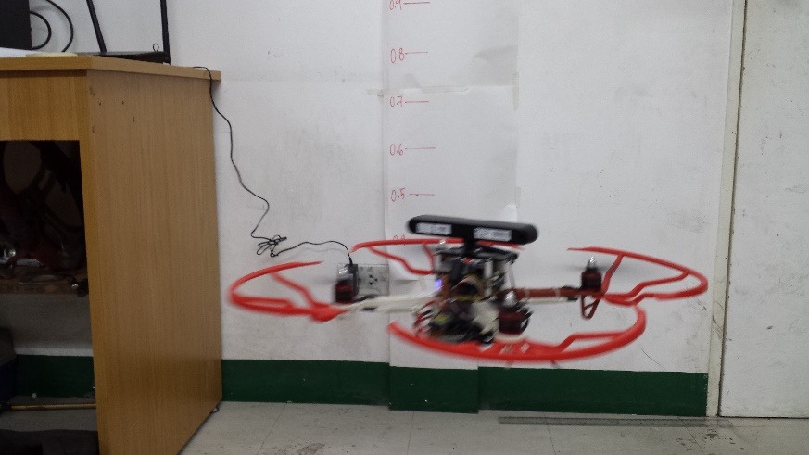
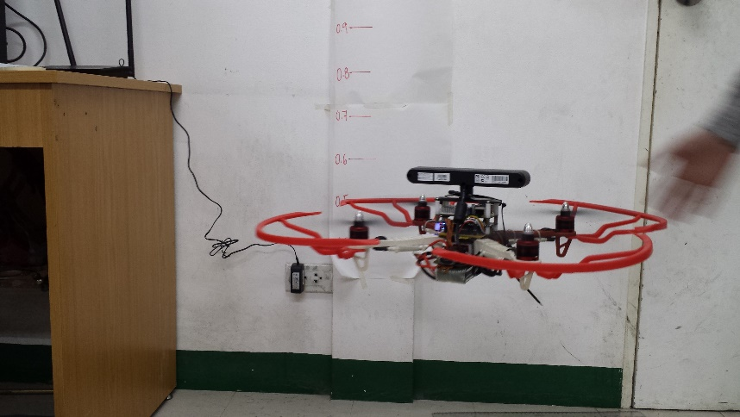
Quadrotor control

Slide 28
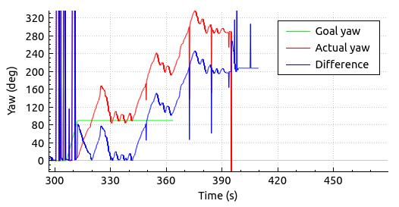
Quadrotor control

Slide 29
System Test

Slide 30
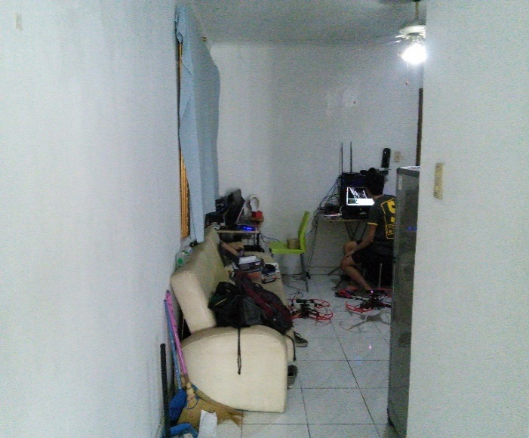
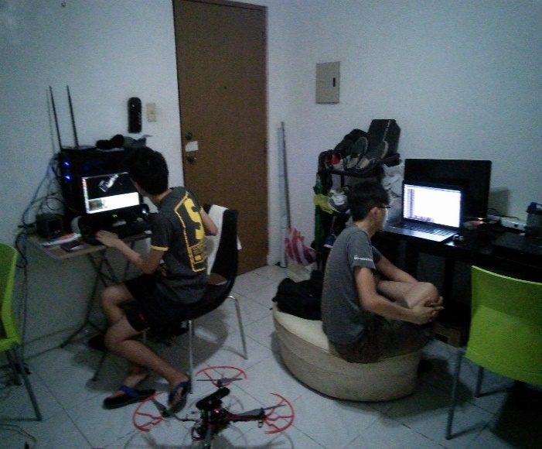
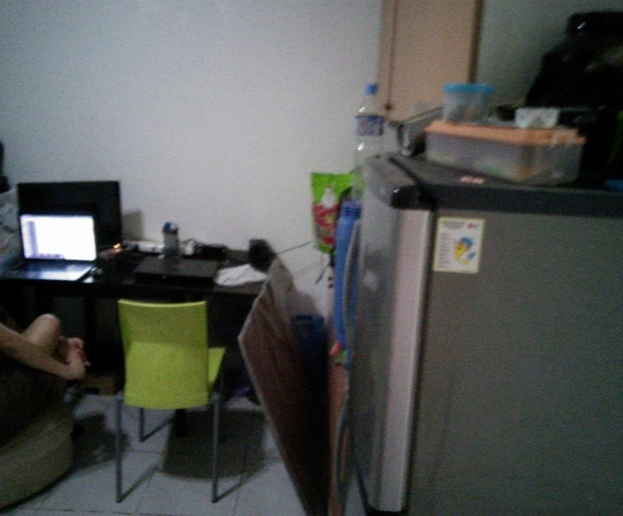
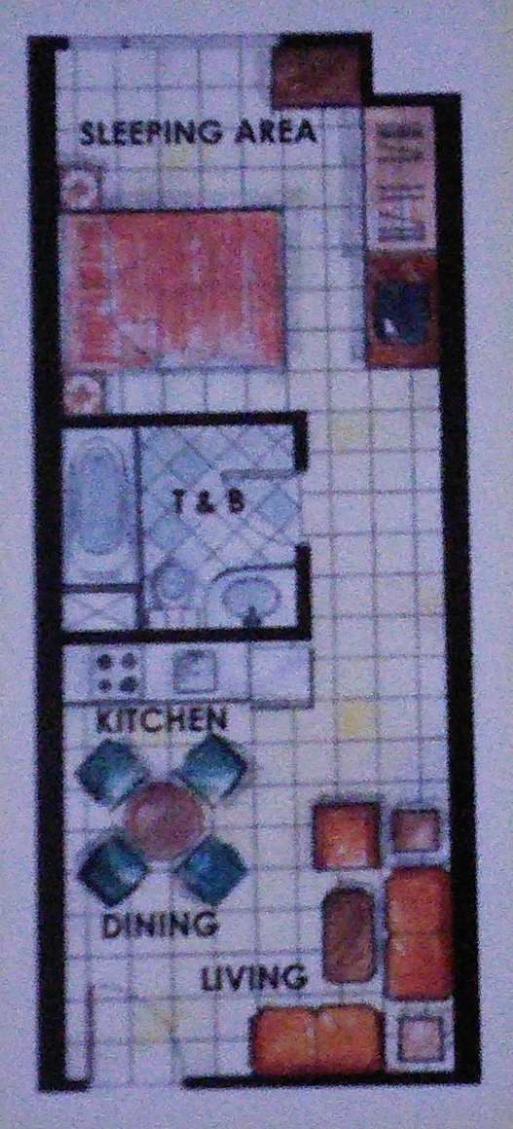
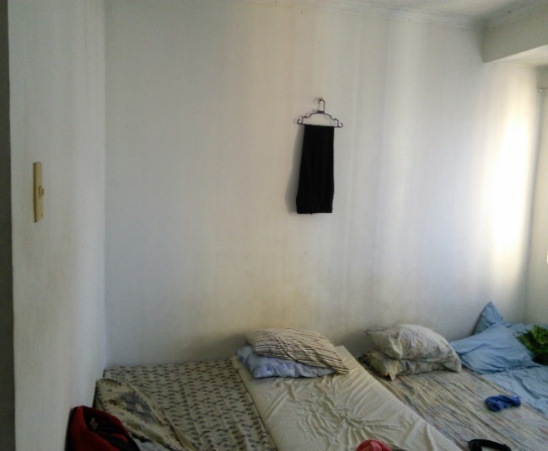
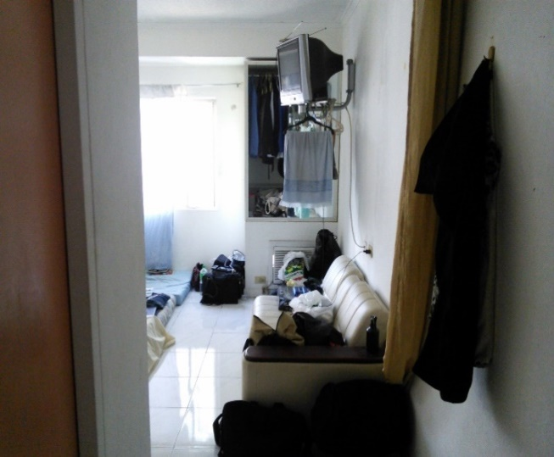
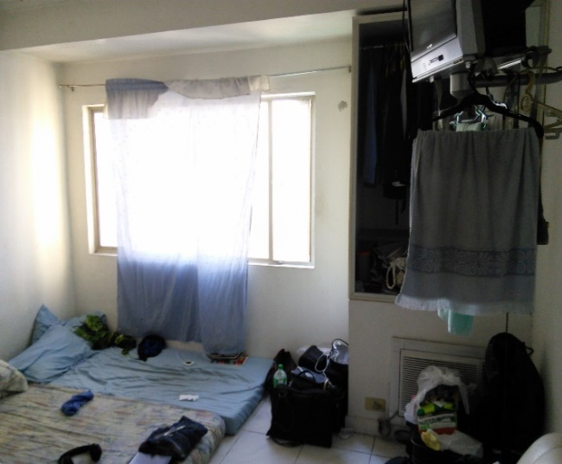
Condo

Slide 31
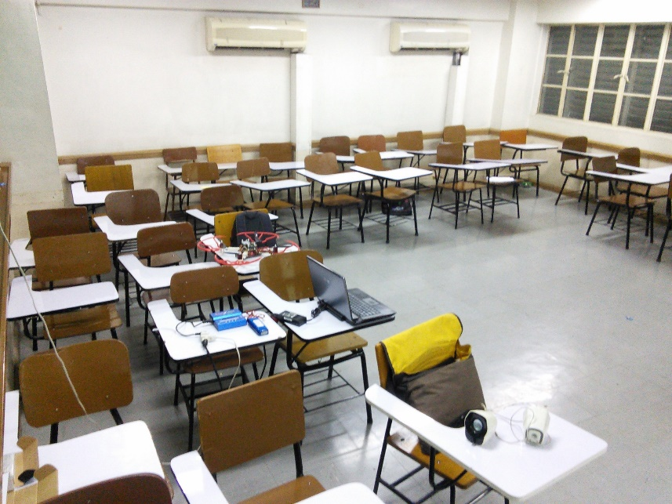
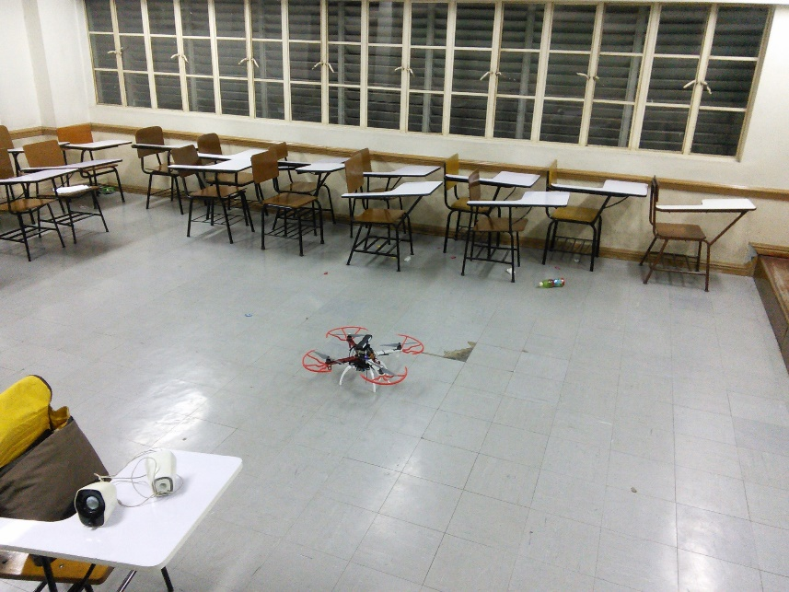
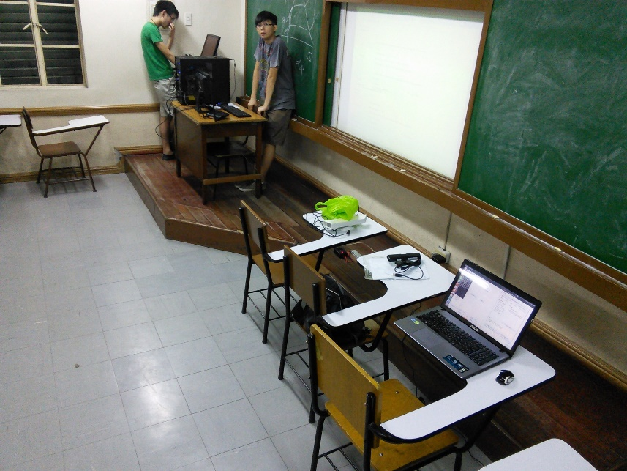
Velasco room v407

Slide 32
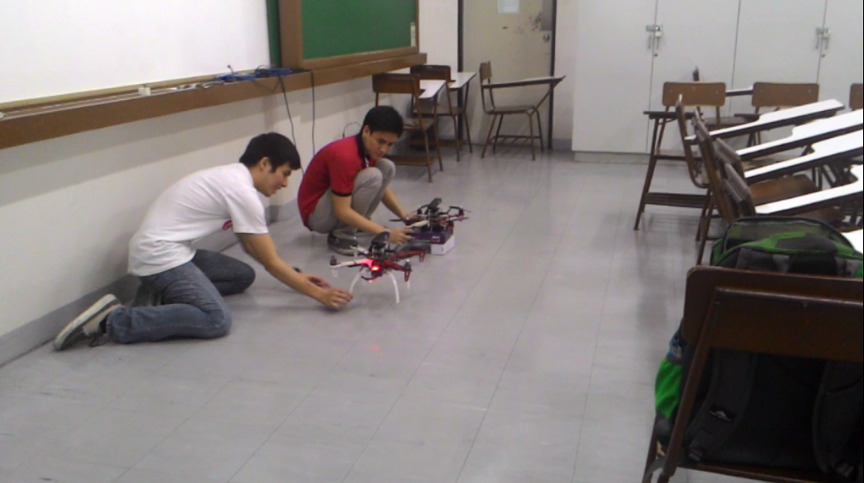
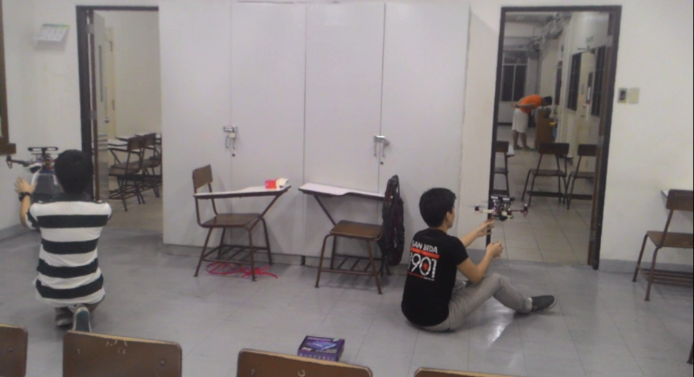
Miguel 2nD floor Room

Slide 33
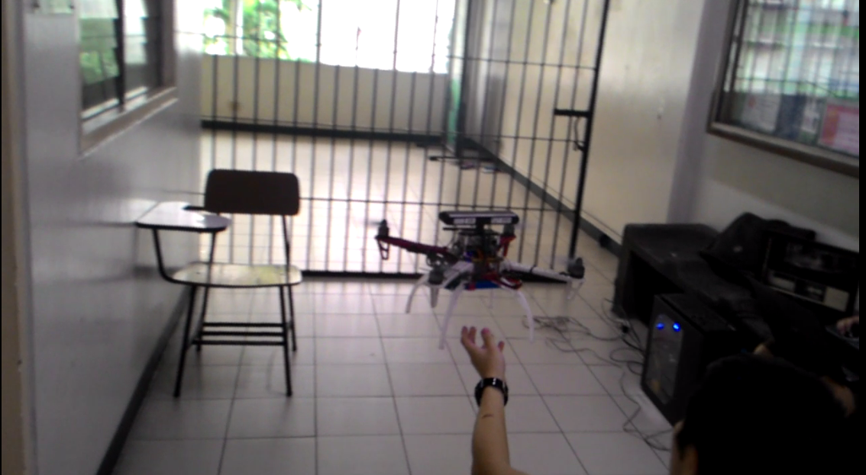
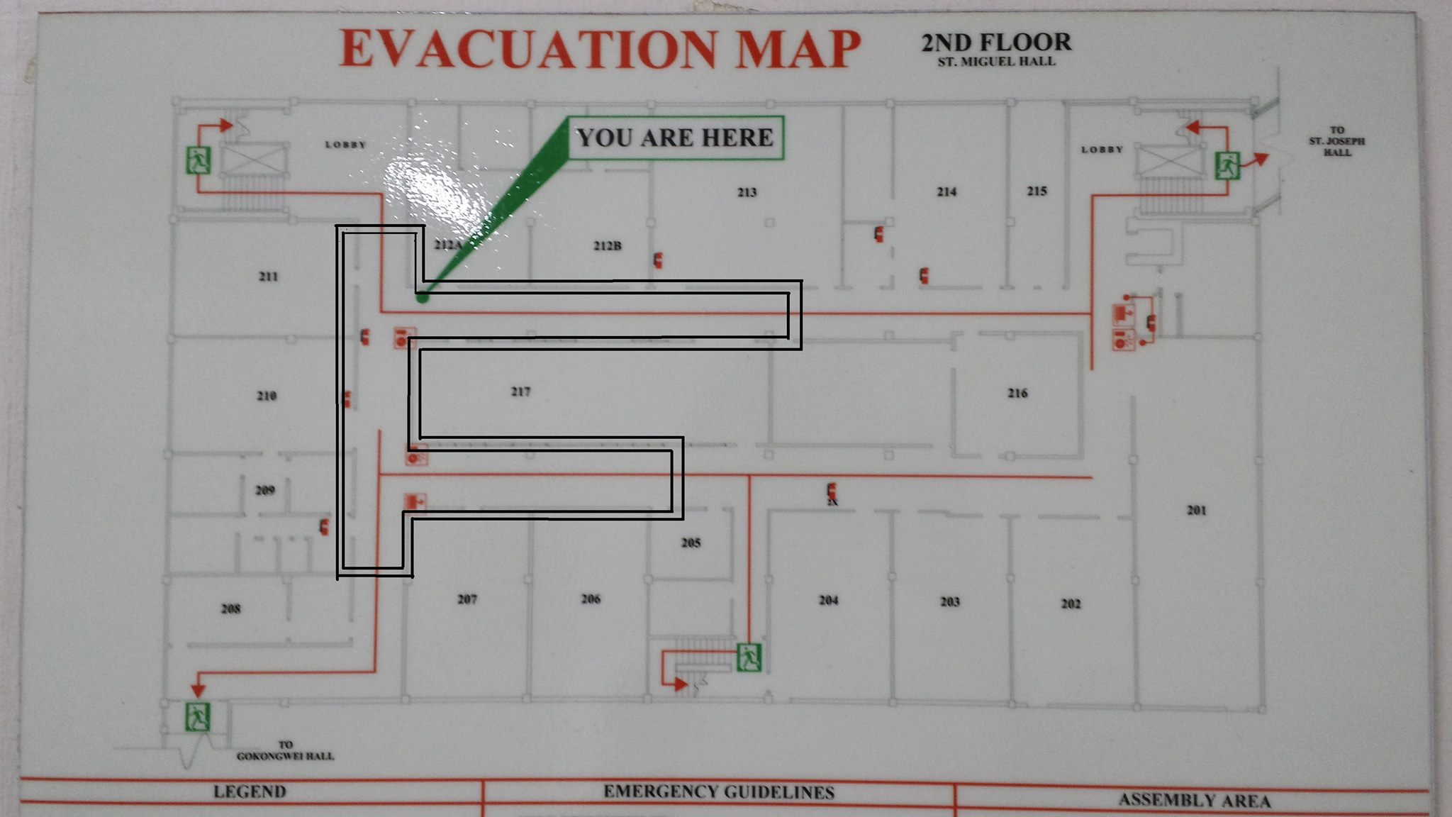
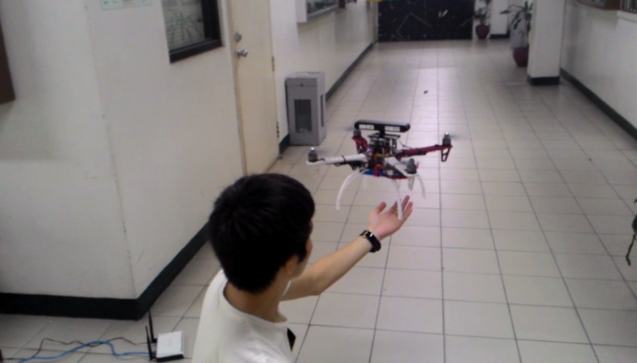
Miguel 2nD floor Hallway

Slide 34
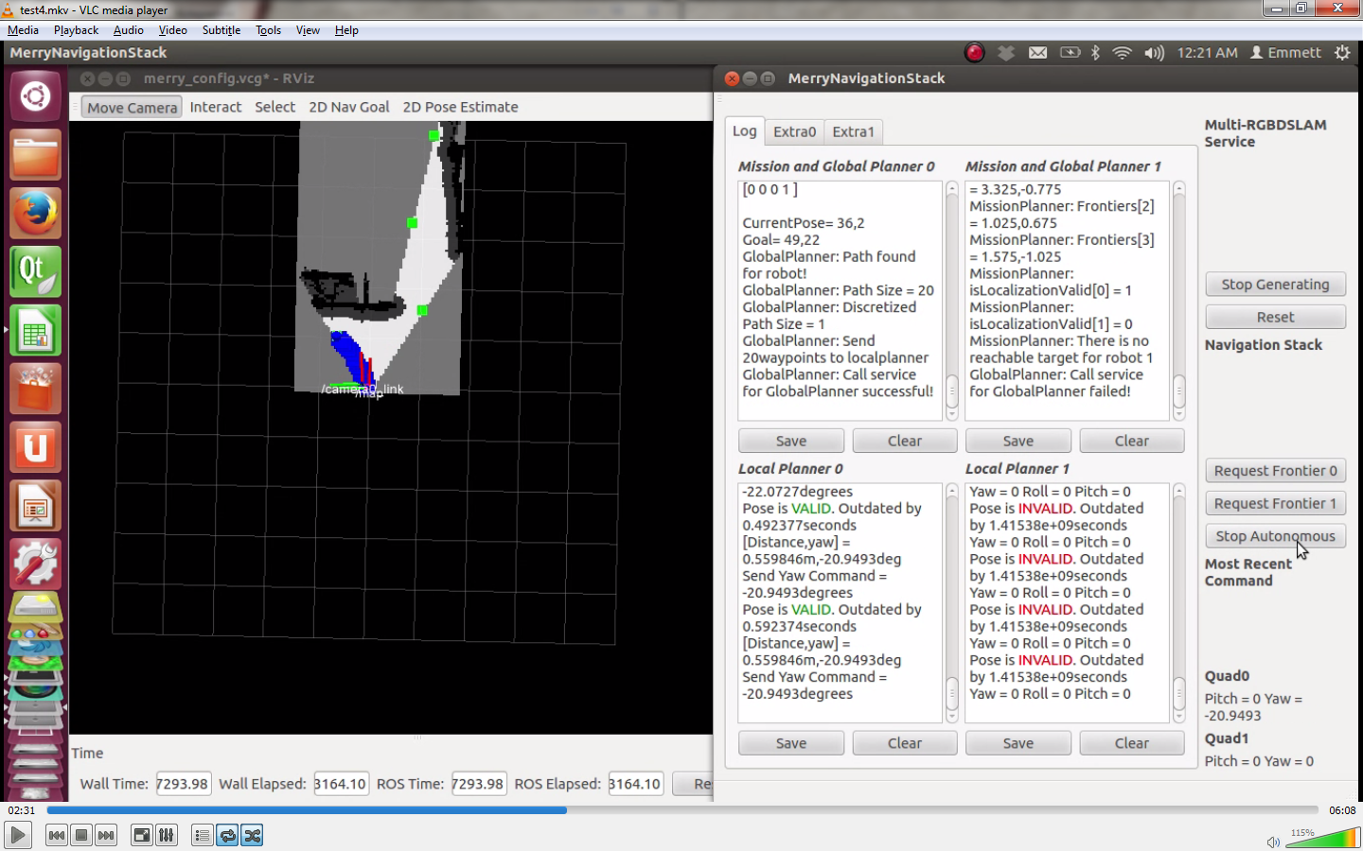
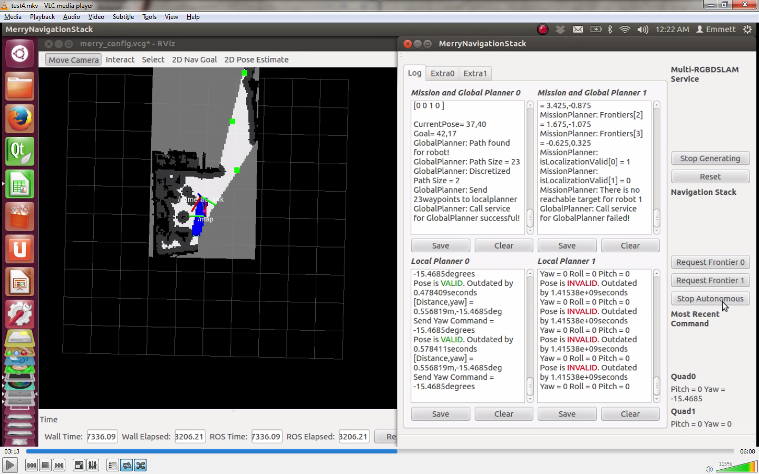
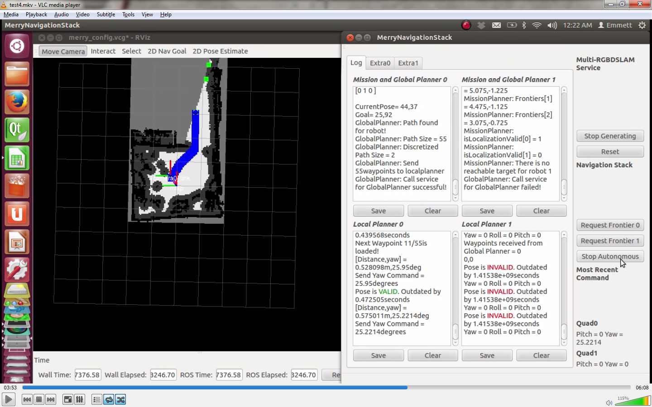
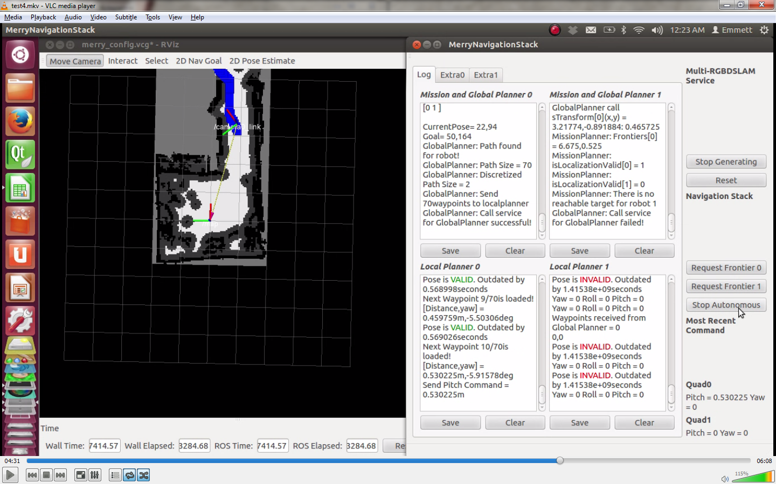
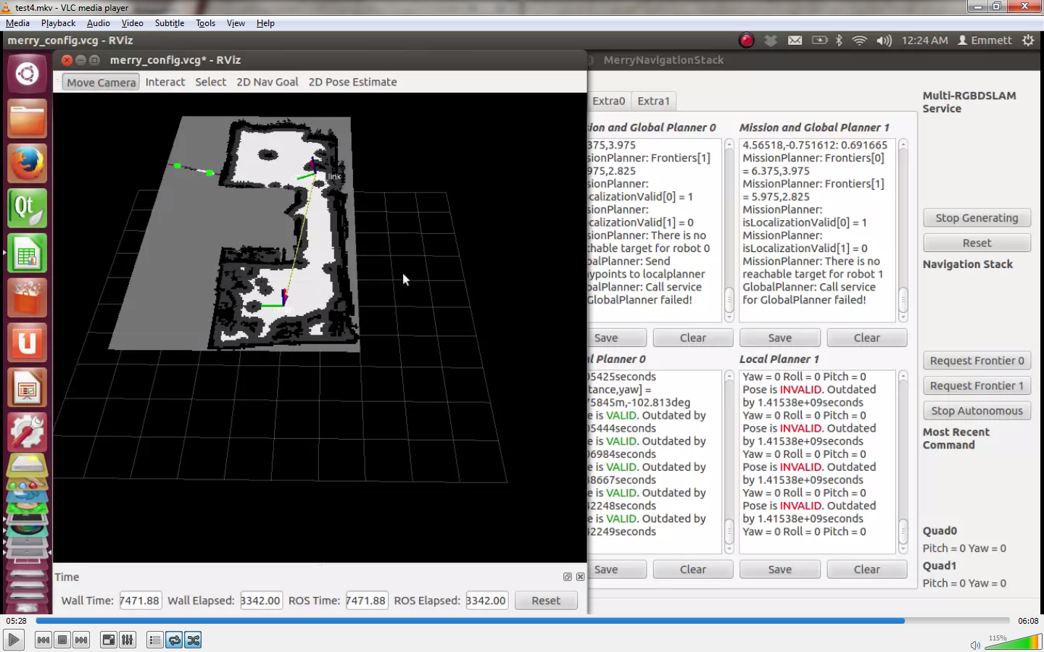
Overall System Test
Condominium – Single Mode

Slide 35
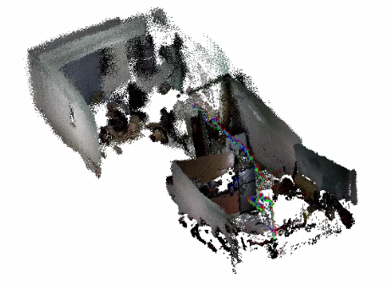
Overall System Test
Condominium – Single Mode

Slide 36
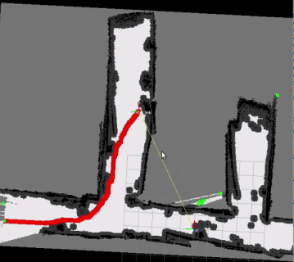
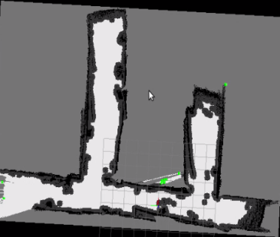
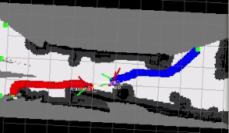
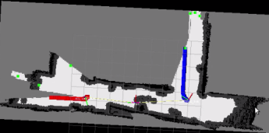
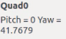
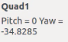
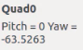
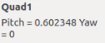
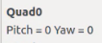
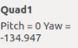
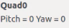
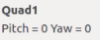
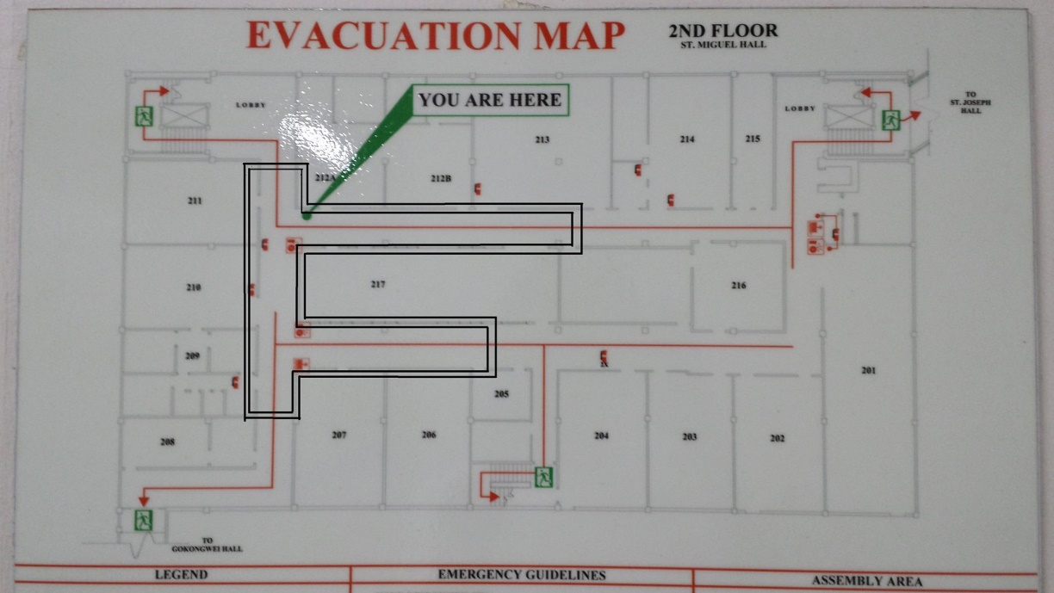
Overall System Test
Miguel 2nd Floor Hallway – Co-op Mode

Slide 37
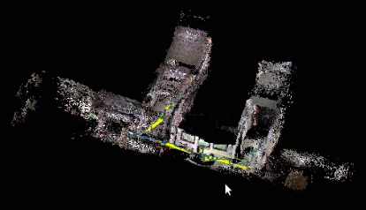
Overall System Test
Miguel 2nd Floor Hallway – Co-op Mode

Slide 38
More maps

Slide 39


Single Mode
Velasco Room

Slide 40


Single Mode
Living and Dining Room in a house

Slide 41


Co-op Mode
Miguel 2nd Floor Room and Hallway

Slide 42


Co-op Mode
Miguel 2nd Floor room only

Slide 43
Conclusions and Recommendations
Multi Robot SLAM
Sufficient in indoor environments with features and depth data of 3 meters.
MonoSLAM could be used to increase versatility in larger environments.
MonoSLAM makes use of an RGB camera and an IMU.
Notes:
The current MULTI RGBDSLAM system is sufficient in indoor environments with features and depth data of 3 meters. Due to the depth sensor limitation, an alternate SLAM technique, such as monoSLAM, could be used when depth sensor data is invalid. MonoSLAM is a SLAM algorithm that makes use of RGB and an IMU.

Slide 44
Conclusions and Recommendations
Control
Control of Quadrotor was achieved successfully.
Maintainable height.
Yaws to the goal angle.
Pitches forward towards the goal.
Unexpected drifting due to the flight controller.
Position control for roll and pitch is recommended for autonomous navigation.

Slide 45
Conclusions and Recommendations
Autonomous Exploration
The navigation stack integrated in our system enables our robots to autonomously explore uncharted territories until all reachable frontiers are exhausted.
Currently, the navigation stack commands the robot to navigate to the frontier targets without considering to scan known areas for loop closures which results to completed map with no loop closures.
Improvements in the navigation stack such as considering loop closures promises a more accurate map.
Even though our 2D exploration algorithm is capable of enabling the robots to operate fully autonomously, it limits the robot to create a complete 3D map. It is recommended to implement 3D navigation to overcome such limitations especially since the robots are flying.

Slide 46
Thank you for listening!

